Slide 1
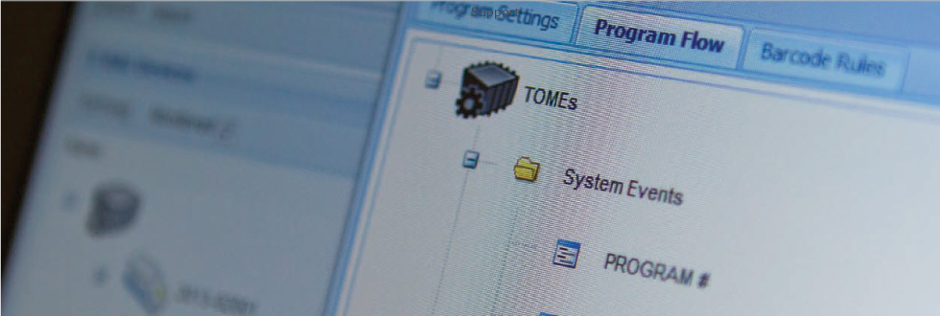
Trima Accel 7 + TOMEs 7
Simulator

Slide 2


Project overview Main topics involved in the project
The
Challenge
The
Solution
All advances unlocked by TOMEs in Trima are very abstract, difficult for operators and internals to understand the real value of the technology
Create a tool to make the features unlocked in Trima with TOMEs as real as possible.
This tool should simulate the actions in the TOMEs and the effects in the Trima

Slide 3
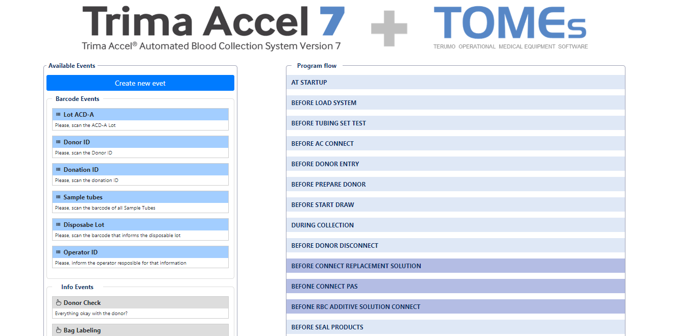

Trima and TOMEs: Simulation Tool Tool that has the dynamics of TOMEs with the simulation of the Trima screen
Web based
Can be used on multiple platforms
Flexible
You can create any type of event and configure the workflow in the best way for your routine
Drag & Drop
The interaction with the system is simple, just click and drag and drop
Trima Screen
Examples of what the Trima screen will look like with the features
Export Function
With the workflow defined, you can export it for use when implementing TOMEs

Slide 4


Next steps What we have already identified as opportunities for improvement so far
Translate to other languages
Spanish and Portuguese to make the tool usable in other regions
Expand to other equipment
Apply the same dynamic to other Terumo technologies
Interact with Salesforce
Create reports that can be incorporated by Salesforce for use as records

